Slide 1

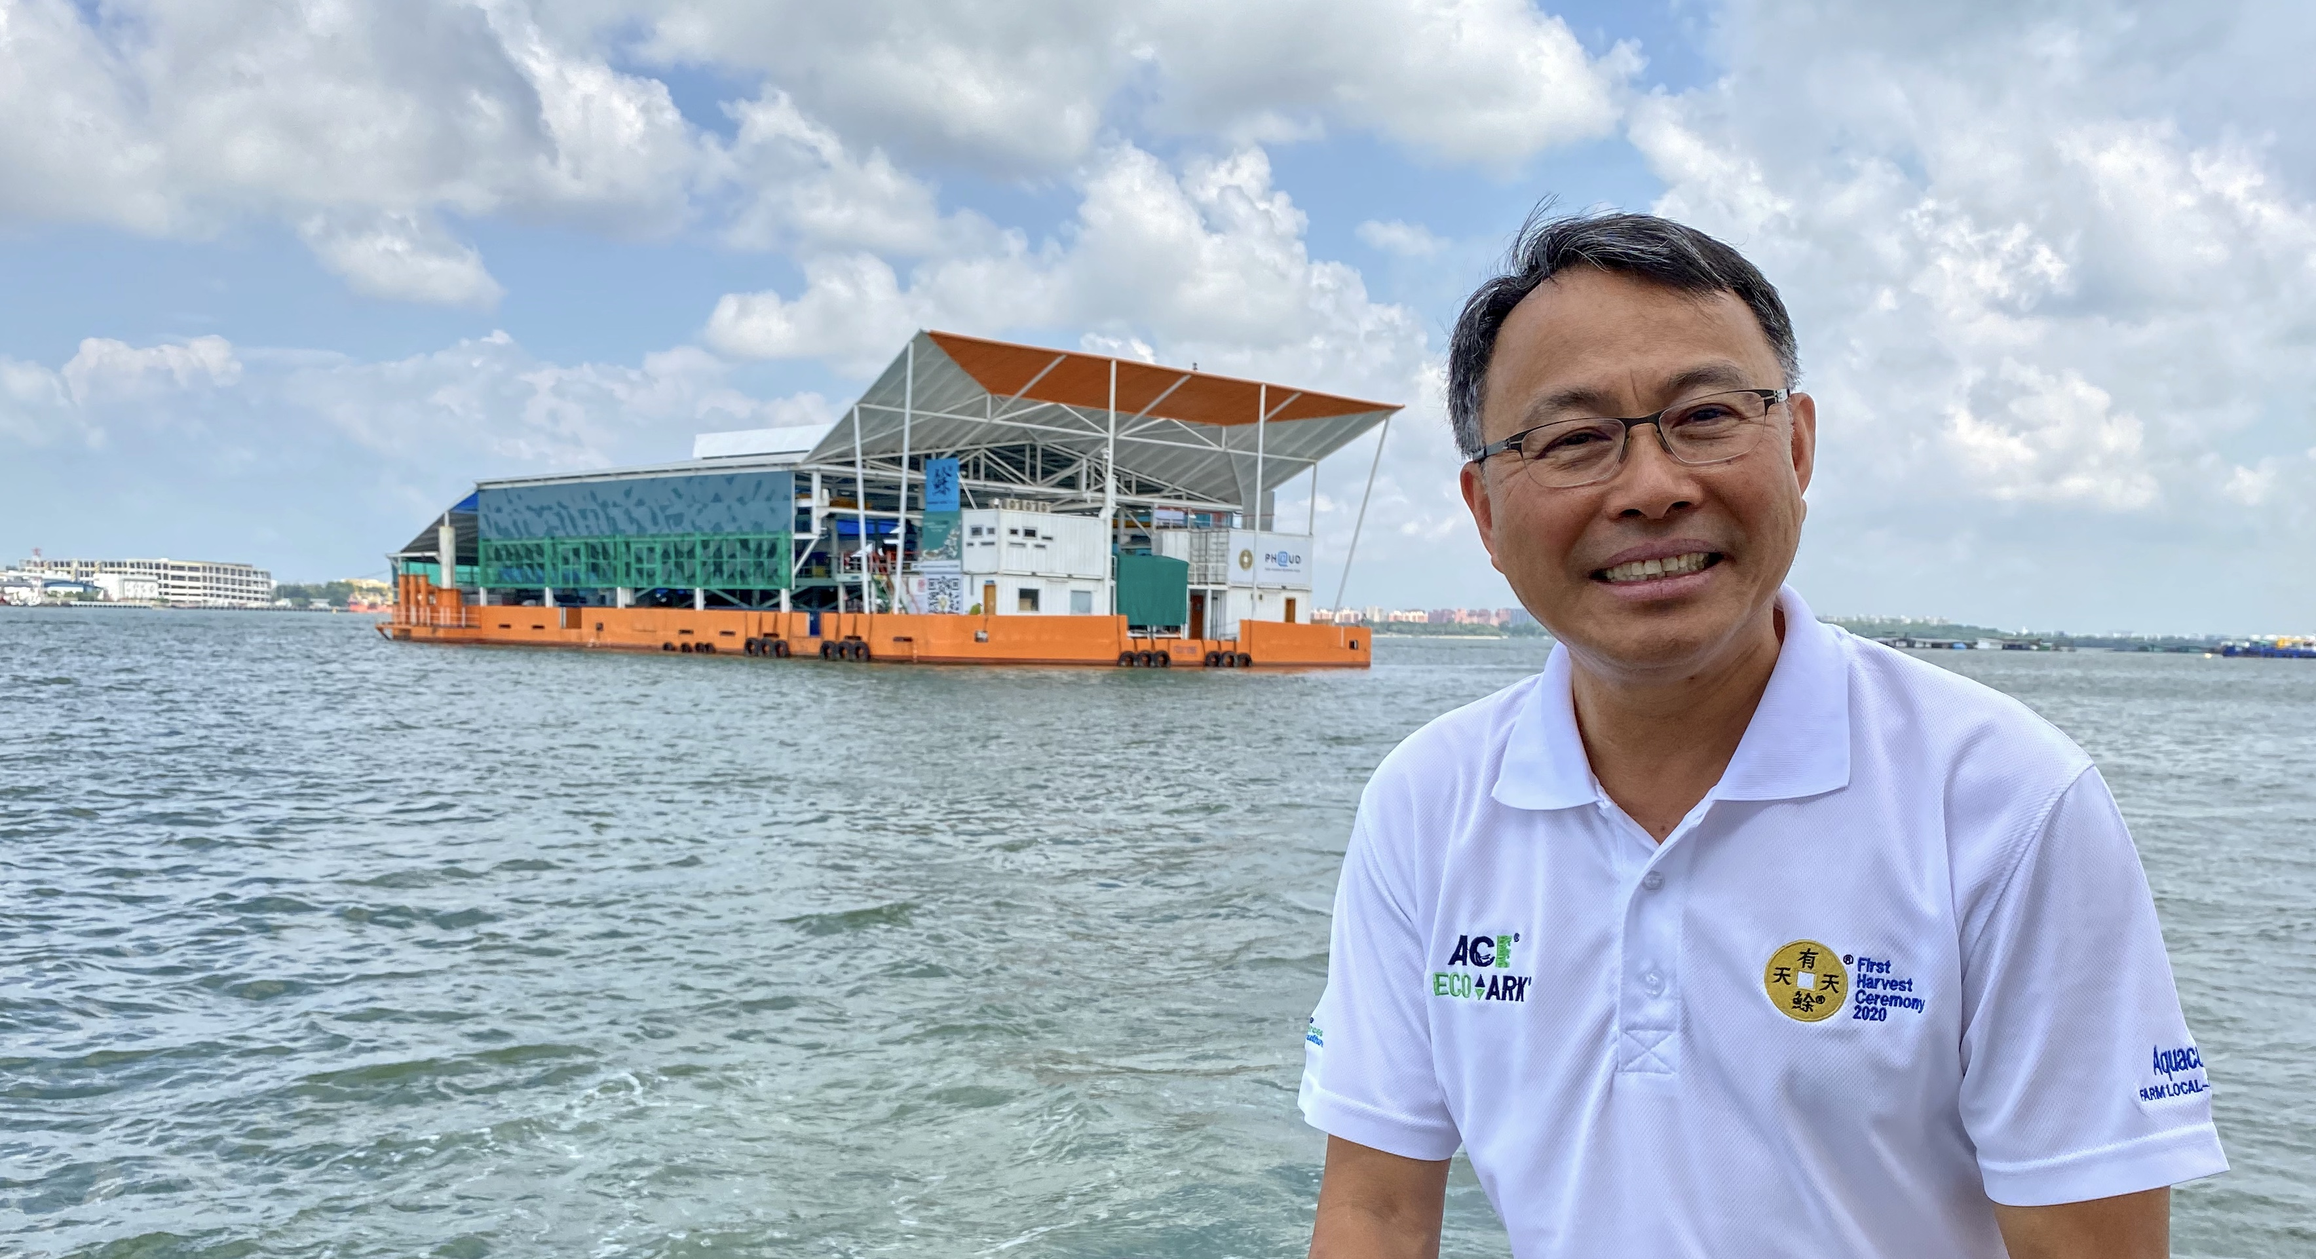
ECO-ARK® Technology enabling sustainable food fish production
Infrastructure and improving sustainability and resilience
ADB WORKSHOP
14 OCTOBER 2021
Mr. Leow has over 40 years of experience in the marine and offshore industry in Singapore and overseas. Mr. Leow is the Founder / CEO of AME2 Pte Ltd, his own consultancy company, Aquaculture Centre of Excellence Pte Ltd (ACE) and Nature Resources Aquaculture Pte Ltd (NRA). He is the inventor of the patented NOAHS Eco-Ark® Floating Closed Containment Fish Farm. Eco-Ark® is a sustainable farm that combines proven marine and offshore technology with aquatic health and post-harvest technology harnessing green energy that makes it the farm of the future. He is also the inventor of the patented Lift-Doc®, an innovative offshore platform.

Slide 2
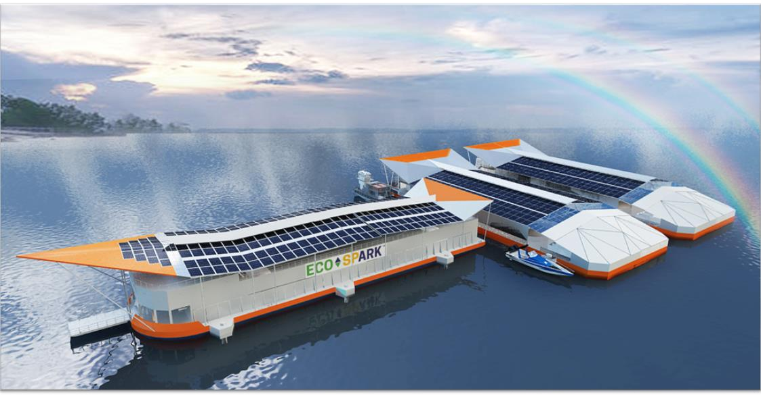


Aquaculture Centre of Excellence Pte Ltd (ACE)
Floating BiPV Solar
ADB WORKSHOP
14 OCTOBER 2021
Infrastructure and Improving Food Sustainability and Resilience

Slide 3
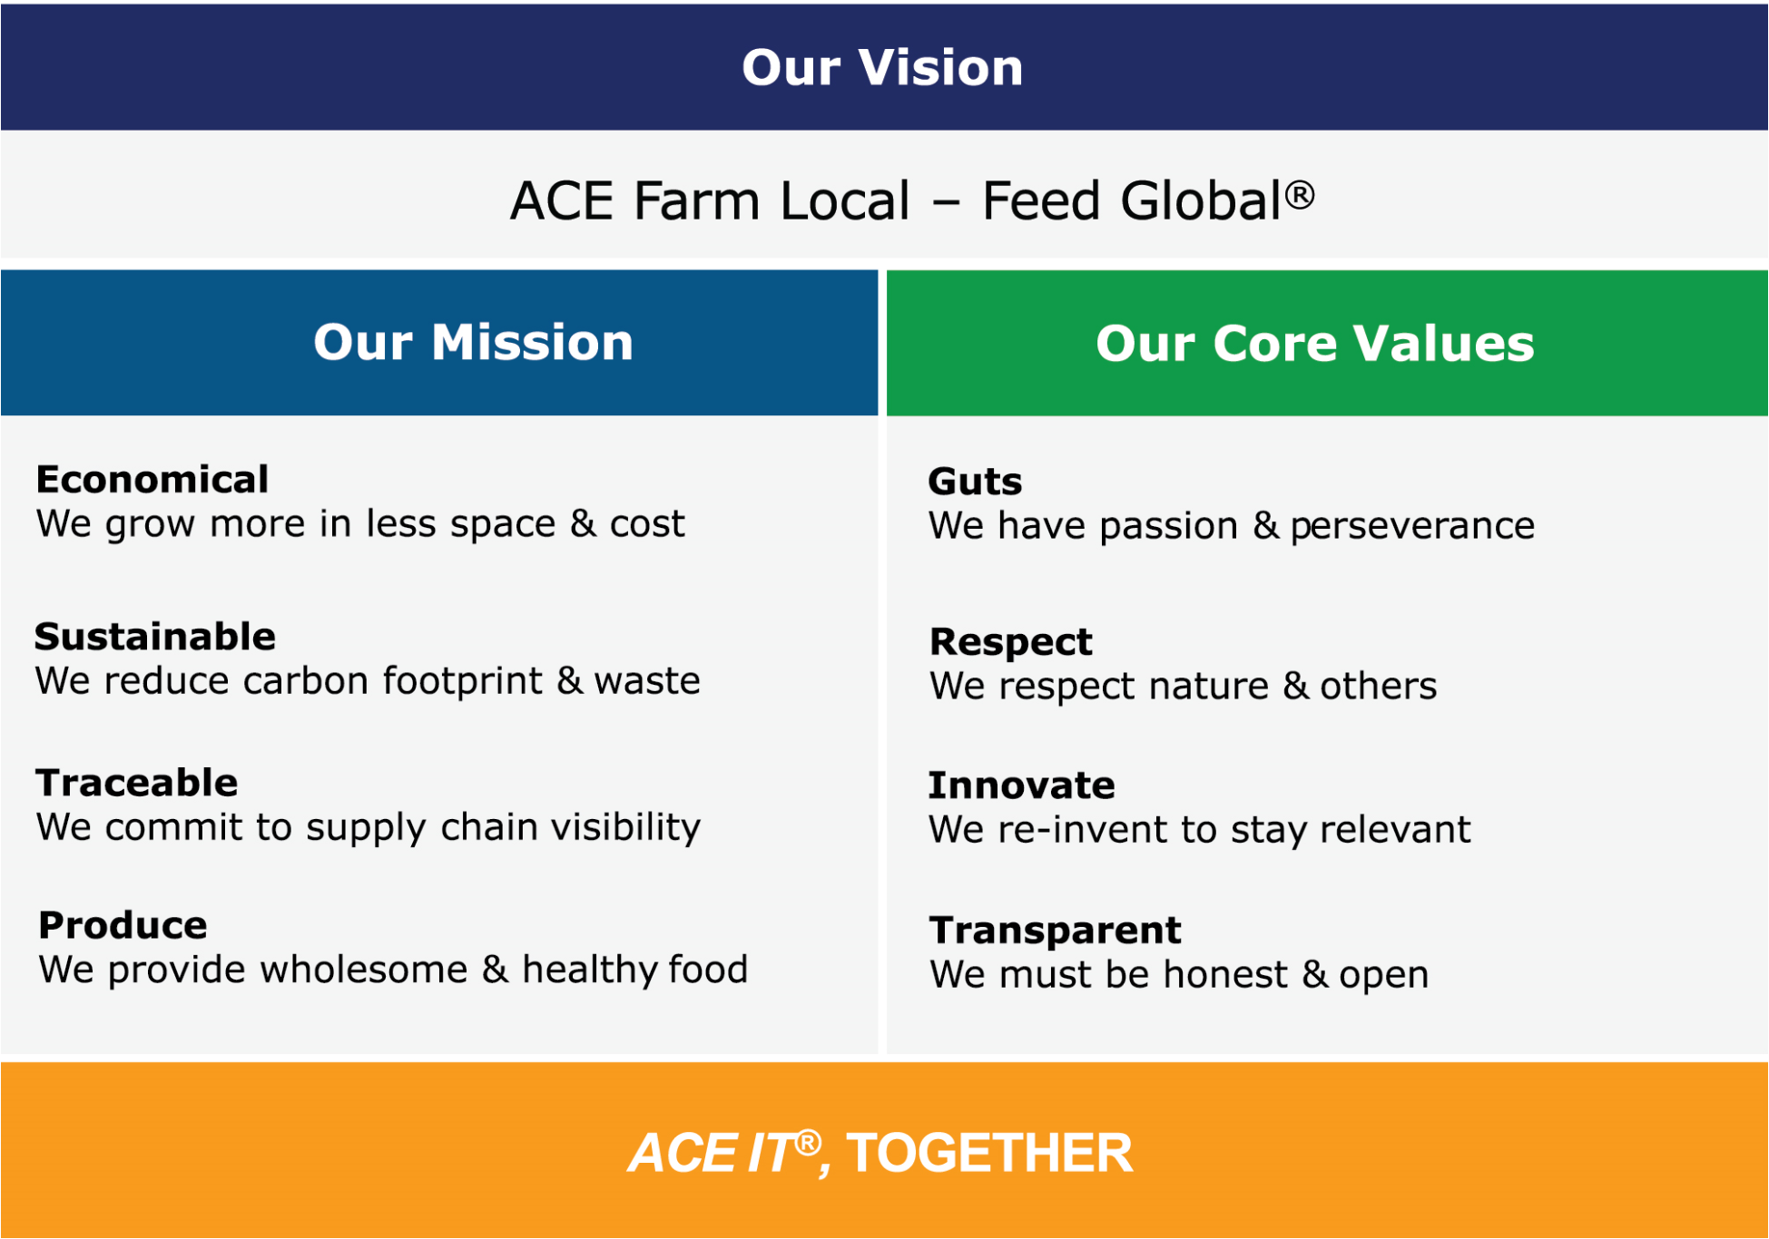
ECO-ARK® Technology enabling sustainable food fish production
ACE GROUP® is a Singapore-based company with a born-global vision from the start
Copyright © ACE 2020. All rights reserved

Slide 4
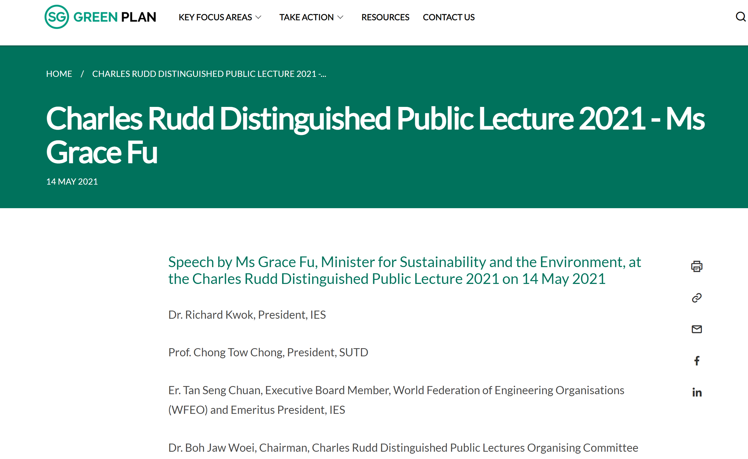
Introduction of ACE ECO-ARK® Technology
“My fourth example is in the agri-food sector, where engineering innovations coupled with animal and plant science will make farming more efficient in terms of land, water, energy, and labour. The ACE Eco-Ark off Changi is one of the world's first closed containment floating fish farms. Its system can toggle between flow through and recirculating water processes, to ensure optimal water condition for its fish. It filters and treats water before discharging it back to the sea. It taps on gravity and head pressure to push seawater through the filtration system towards final discharge. This exemplifies the potential of fish farming that is productive and protective of the marine environment. We are supporting these efforts through our S$144 million Singapore Food Story R&D Programme which supports research in sustainable urban food production technologies and a new S$60 million Agri-Food Cluster Transformation (ACT) Fund to spur transformation in the agri-food sector.” unquote.
Speech by Ms Grace Fu, Minister for Sustainability and the Environment
Copyright © ACE 2020. All rights reserved

Slide 5
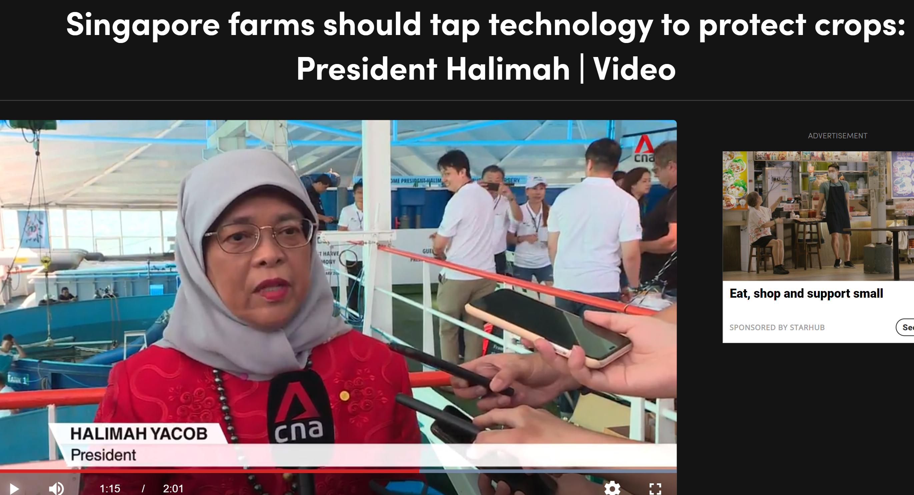
https://www.channelnewsasia.com/watch/singapore-farms-should-tap-technology-protect-crops-president-halimah-video-1484201
President Halimah as GOH for the ACE - First Harvest & Thanksgiving Ceremony on 27th February 2020

Slide 6

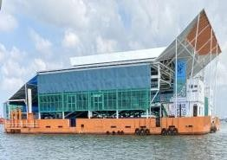
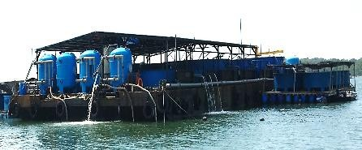
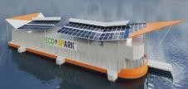

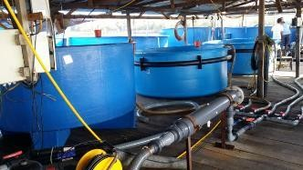
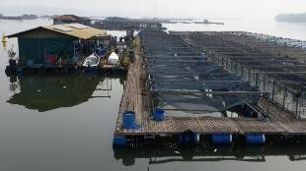

ECO-ARK® Technology enabling sustainable food fish production
ACE GROUP® is pioneering the future of sustainable aquaculture technology and transforming
Singapore’s coastal fish farming landscape along with ESG - SDG considerations.
Productivity
Smart floating
farms
Adapted floating
barge
Purpose-built floating
structure
Highly automated
More sustainability
features
Improved stability
to support large- Tanks on wooden scale production platform
Improved resilience
Structure unable to
support mec hanisation
Facts:
121* fish farms (only 12 are land-based)
Uses 100* hectares sea space
2020 production 3,960**tonnes
c.5% of local consumption
Farming model of the future for regional coastal/ inland areas
Open net cages
Most existing farms
Vulnerable to adverse environment
No control over disease spread
Level of technology sophistication
Sourc e: A dapted from Figure 7 https://www.was.org/articles/The-Singapore-Aquaculture-Industry-Contributing-to-Singapores-Food-Security.aspx#
Notes:
AQUACULTURE 1.0
A more traditional method of aquaculture, whereby labour is intensive using tools and manpower
Heavy reliance on the natural environment
to grow their stock
AQUACULTURE 2.0
Utilising technology to a certain extent aids in aquatic health and husbandry of the target species
Have a small degree of control over water
parameters
AQUACULTURE 3.0
Typically land-based RAS system, floating barge or large net-cage technology of varying designs
Automation – equipped with monitoring and control system that aids in the husbandry technique
Facilities are more productivity oriented
AQUACULTURE 4.0
Innovative game-changing closed- containment aquaculture system, whereby hi-tech farms embrace aquaculture 4.0 in a more holistic and integrated way
This generation of aquaculture farms not only focuses on productivity, climate resilience and self-sufficiency, but also on sustainability and the use of technology

Slide 7






ECO-ARK® Technology enabling sustainable food fish production
TRANSFORMATION OF NEAR SHORE ISLAND FARM REQUIRE TECHNOLOGY
TECHNOLOGY
FARM
TO
FOOD
SDG
GOAL
SUSTAINABILITY
Singapore Food Agency’s 30×30 Goal
Copyright © ACE 2020. All rights reserved

Slide 8
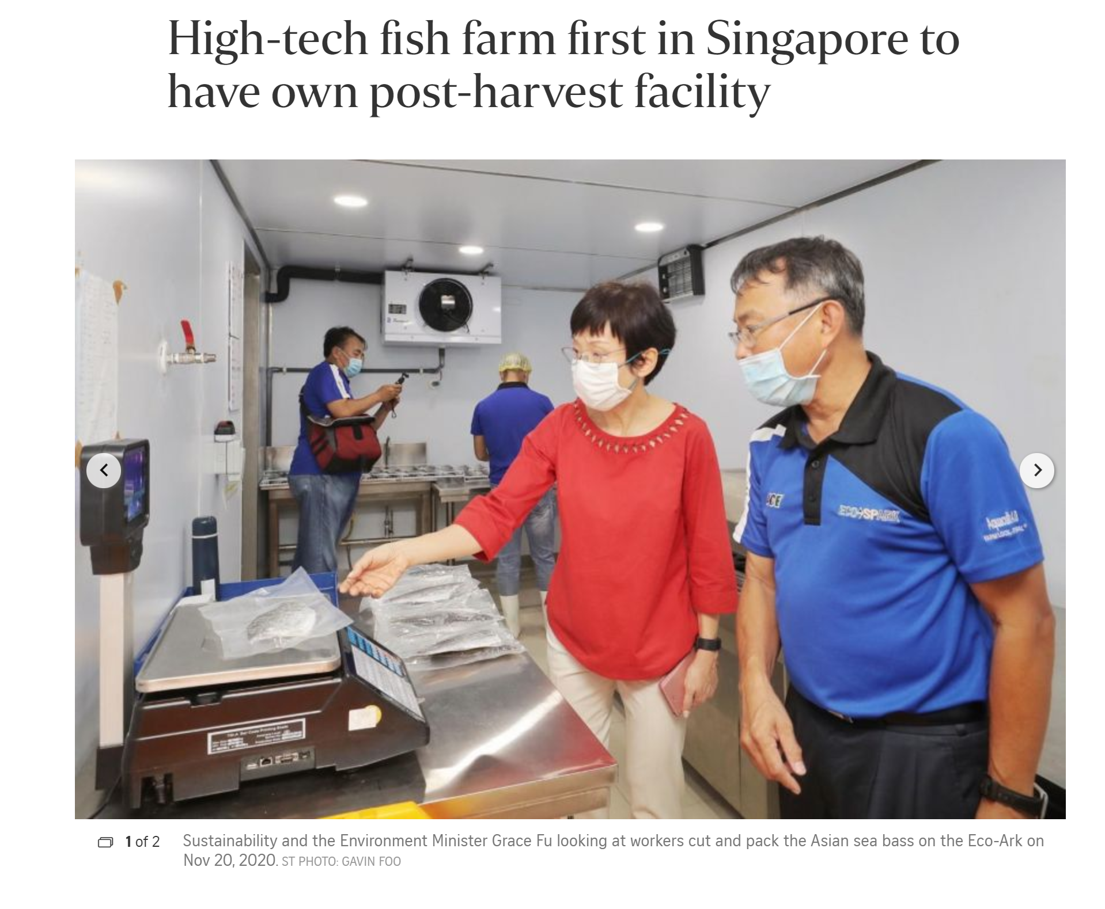
ECO-ARK® Technology enabling sustainable food fish production
20 Nov 2020
Copyright © ACE 2020. All rights reserved

Slide 9
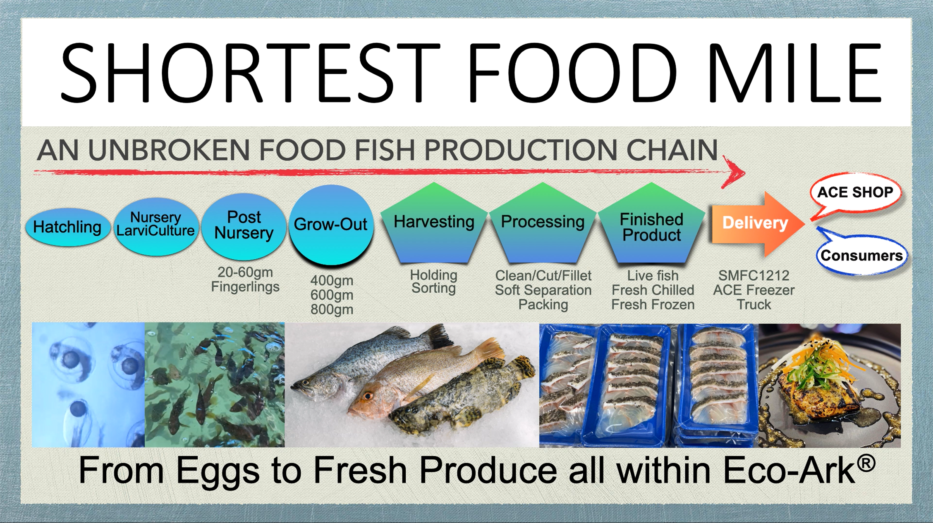
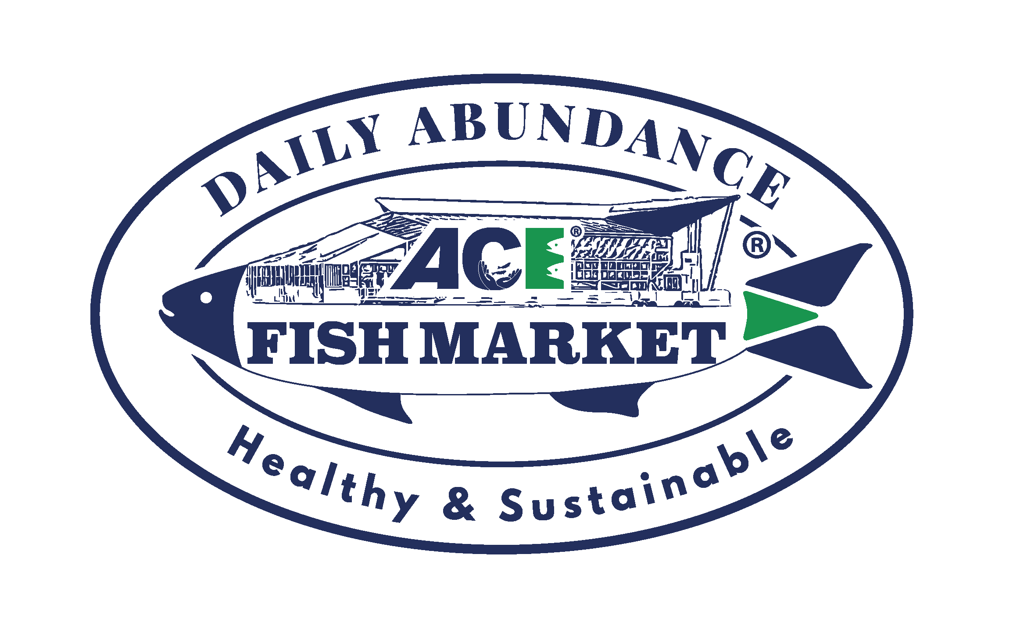
Embrace Technology in the Aquaculture Industry
Copyright © ACE 2020. All rights reserved

Slide 10
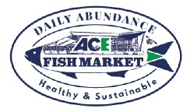

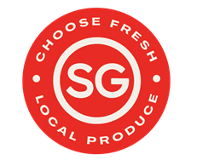






Farm to Fork from ECO-ARK® & ECO-SPARK® to ACE SHOP
SG TO SG
Local Market
Sales to Order (STO)
Sales & Marketing
Post-Harvest Ops
Farm Operations
CUSTOMERS
Sales to Order (STO)
Process to Sales (PTS)
Farm to Process (FTP)
Export Market
Collaborating
Off-taking
Licensing
Copyright © ACE 2020. All rights reserved

Slide 11
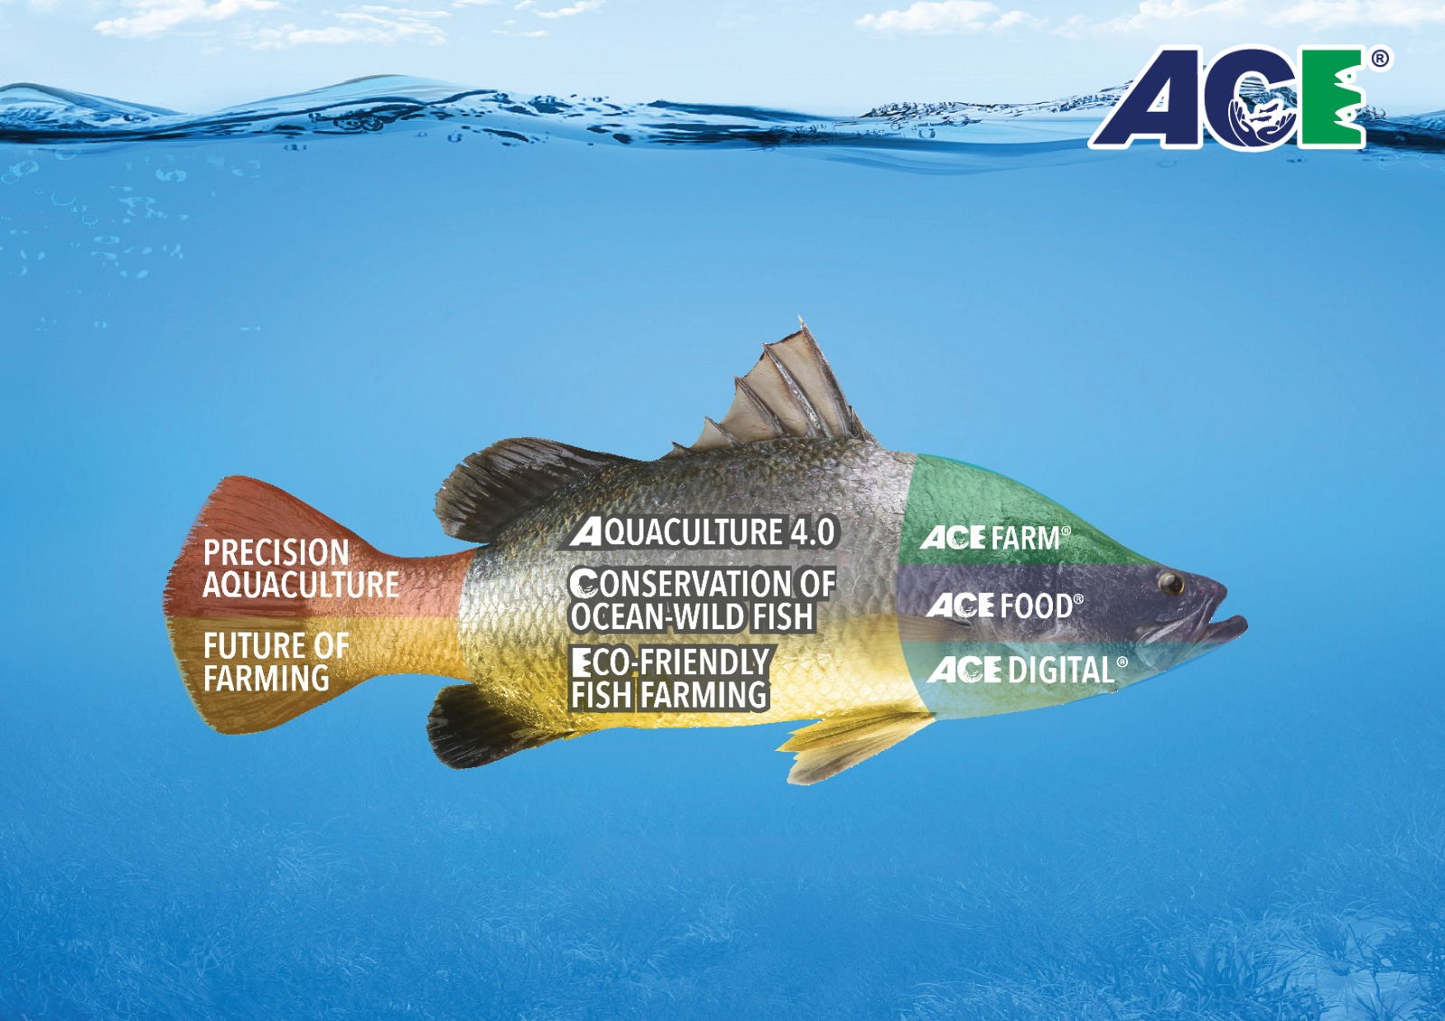

DAILY ABUNDANCE FOR ISLAND FOOD SECURITY
Copyright © ACE 2020. All rights reserved

Slide 12
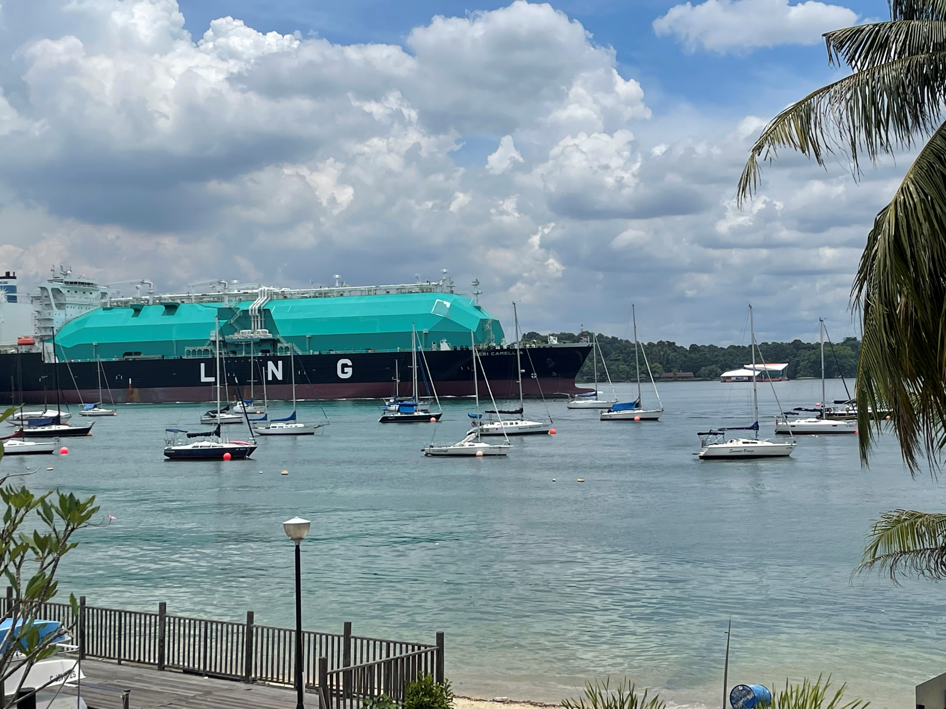

THANK YOU
CAN YOU SPOT ECO-ARK®?

